Slide 1
Providing Access & Transforming Health
Tri-Counties CalAIM PATH Collaborative
March 20, 2024

Slide 2
Providing Access & Transforming Health
Welcome!
Please introduce yourself using Chat.
Name
Organization
Your role in CalAIM implementation

Slide 3
March Collaborative Agenda
Topic | Time
Welcome and Introductions | 5
Recuperative Care Deep Dive New DHCS Resource on Homelessness Services National Health Foundation Presentation CAPSLO Presentation | 30
Breakout Rooms: MCP Updates Room 1: Santa Barbara and San Luis Obispo Room 2: Ventura | 15
Updates, Announcements, and Closing | 10
Optional Office Hours | 45

Slide 4
2024 Aim Statement and Drivers
The Collaborative will increase the number of members referred to ECM and Community Supports, and the number of those successfully enrolled in and utilizing services.
Build education and awareness of CalAIM among members, providers, and community partners
Strengthen the provider network to serve all Populations of Focus
Increase ECM & Community Supports referrals and care coordination among providers

Slide 5
March Spotlight: Recuperative Care

Slide 6
DHCS Spotlight on Individuals and Families Experiencing Homelessness
Highlights:
ECM delivery strategies
Approaches to outreach and engagement
Example cases/vignettes
Access the resource here

Slide 7
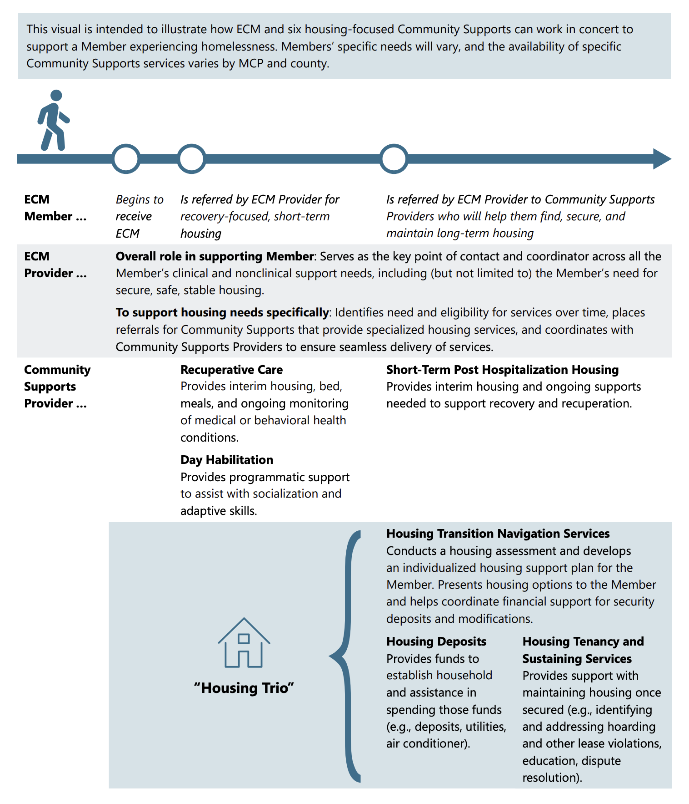
DHCS
Resource:
Individuals Experiencing Homelessness

Slide 8
Providing Access & Transforming Health
Recuperative Care (Medical Respite)
Members with unstable housing who no longer require hospitalization, but still need to heal from an injury or illness, receive short-term residential care. The residential care includes housing, meals, ongoing monitoring of the member’s condition, and other services like coordination of transportation to appointments.

Slide 9
National Health Foundation (NHF)
Recuperative Care Provider

Slide 10
Community Action Partnership of San Luis Obispo County (CAPSLO)
Recuperative Care Provider

Slide 11
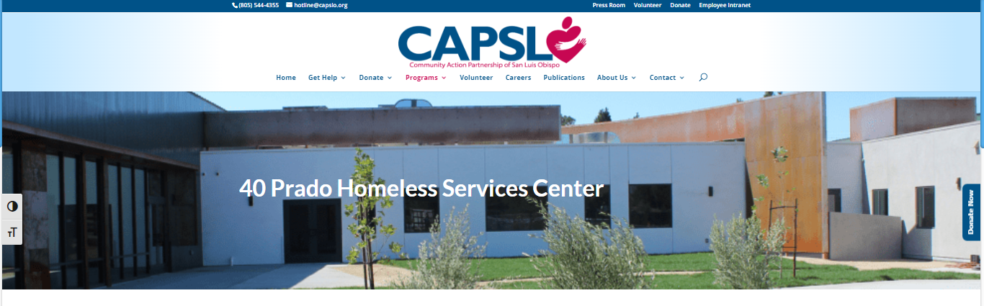
CAPSLO Recuperative Care
https://capslo.org/40-prado/

Slide 12
Discussion

Slide 13
Breakout Rooms: MCP Updates
Santa Barbara and San Luis Obispo
Ventura

Slide 14
Events and Announcements

Slide 15
Upcoming TA Marketplace Vendor Fairs
Hosted by DHCS, virtual vendor fairs feature approved vendors in specific TA Marketplace domains so you can learn more about their services
Domain 5: Promoting Health Equity; and Domain 6: Supporting Cross-Sector Partnerships April 25, 9 -10:30 a.m. Advance registration is required

Slide 16
2024 Collaborative Schedule
May Ventura In-Person: SB/SLO in-person:
June Full Collaborative June 26 TIME ZOOM
Full Collaboratives (Virtual)
County-Specific Working Groups (Virtual)
County-Specific In-Person Meetings

Slide 17
Thank you!
Questions or suggestions?
pathinfo@bluepathhealth.com

Slide 18
Providing Access & Transforming Health
Office Hours

Slide 19
Providing Access & Transforming Health
Appendix

Slide 20
2024 Collaborative Aim Statement
The Collaborative will increase the number of members referred to ECM and Community Supports, and the number of those successfully enrolled in and utilizing services.
Measurement 1: Increased number of total referrals by 15% compared with 2023
Measurement 2: Maintaining at least 25% enrollment rate

Slide 21
TA Marketplace
Application Review Timeline

Slide 22
Timeliness of Application Review
Recipient Eligibility Applications
Average review time was under 2 weeks, which was primarily dependent on the receipt of identity verification data and the quality of attestations submitted. Where an organization submitted a blank or incorrect attestation, the timeline from submission to approval was significantly longer.
Identity Verification 3 days | PCG Attestation Review - 3 days | DHCS Approval 1 week
Project Eligibility Applications
Average review by PCG staff was 5 business days, followed by 5 business days to receive DHCS approval. This process proceeded quickly for most applicants, as the majority of requests were for Off-the-Shelf projects, for which the project goals are clearly defined and outlined. Projects with longer reviews at the PEA step of the process were due to unclear goals or applications that contained requests for multiple disparate projects.
PCG Review 1 week | DHCS Approval 1 week

Slide 23
Timeliness of Application Review (cont.)
Scopes of Work and Budgets (standard review)
Average review by PCG staff was 5 business days, followed by 5 business days to receive DHCS approval. This process proceeded quickly for most applicants, as the majority of requests were for Off-the-Shelf projects, for which the review is expedited, as project goals are clearly defined and outlined.
PCG Review 1 week | DHCS Approval 1 week
Scopes of Work (SOW) and Budgets (heightened scrutiny)
SOW and Budgets may be flagged for heightened scrutiny by the DHCS Team, if concerns are raised at the PEA stage, if there is a concern about duplication of funding from CITED or another grant, or if the project will produce member facing materials.

Slide 24
TA Marketplace Resources
For technical support or questions, please email ta-marketplace@ca-path.com
PATH TPA Website
DHCS CalAIM PATH Webpage

